Slide 1
Is Alzheimer’s Becoming More Prevalent Over Time?
DSC500-T303
Jake Rickord
October 2020

Slide 2
BACKGROUND
Alzheimer’s Disease affects over 5 million Americans.
It is currently the 6th highest cause of death in the U.S. as of 2020 (Hastings, 2020).
The United States is accelerating its progress into a Stage 5 demographic transition model, which is characterized by falling birth rates and higher death rates(BBC, n.d.)
Thus the number of older Americans will continue to dominate the U.S. populace.
Therefore, if the number of elderly in the United States are increasing, we would expect the quantity and percentage of U.S. persons affected by Alzheimer’s to increase

Slide 3
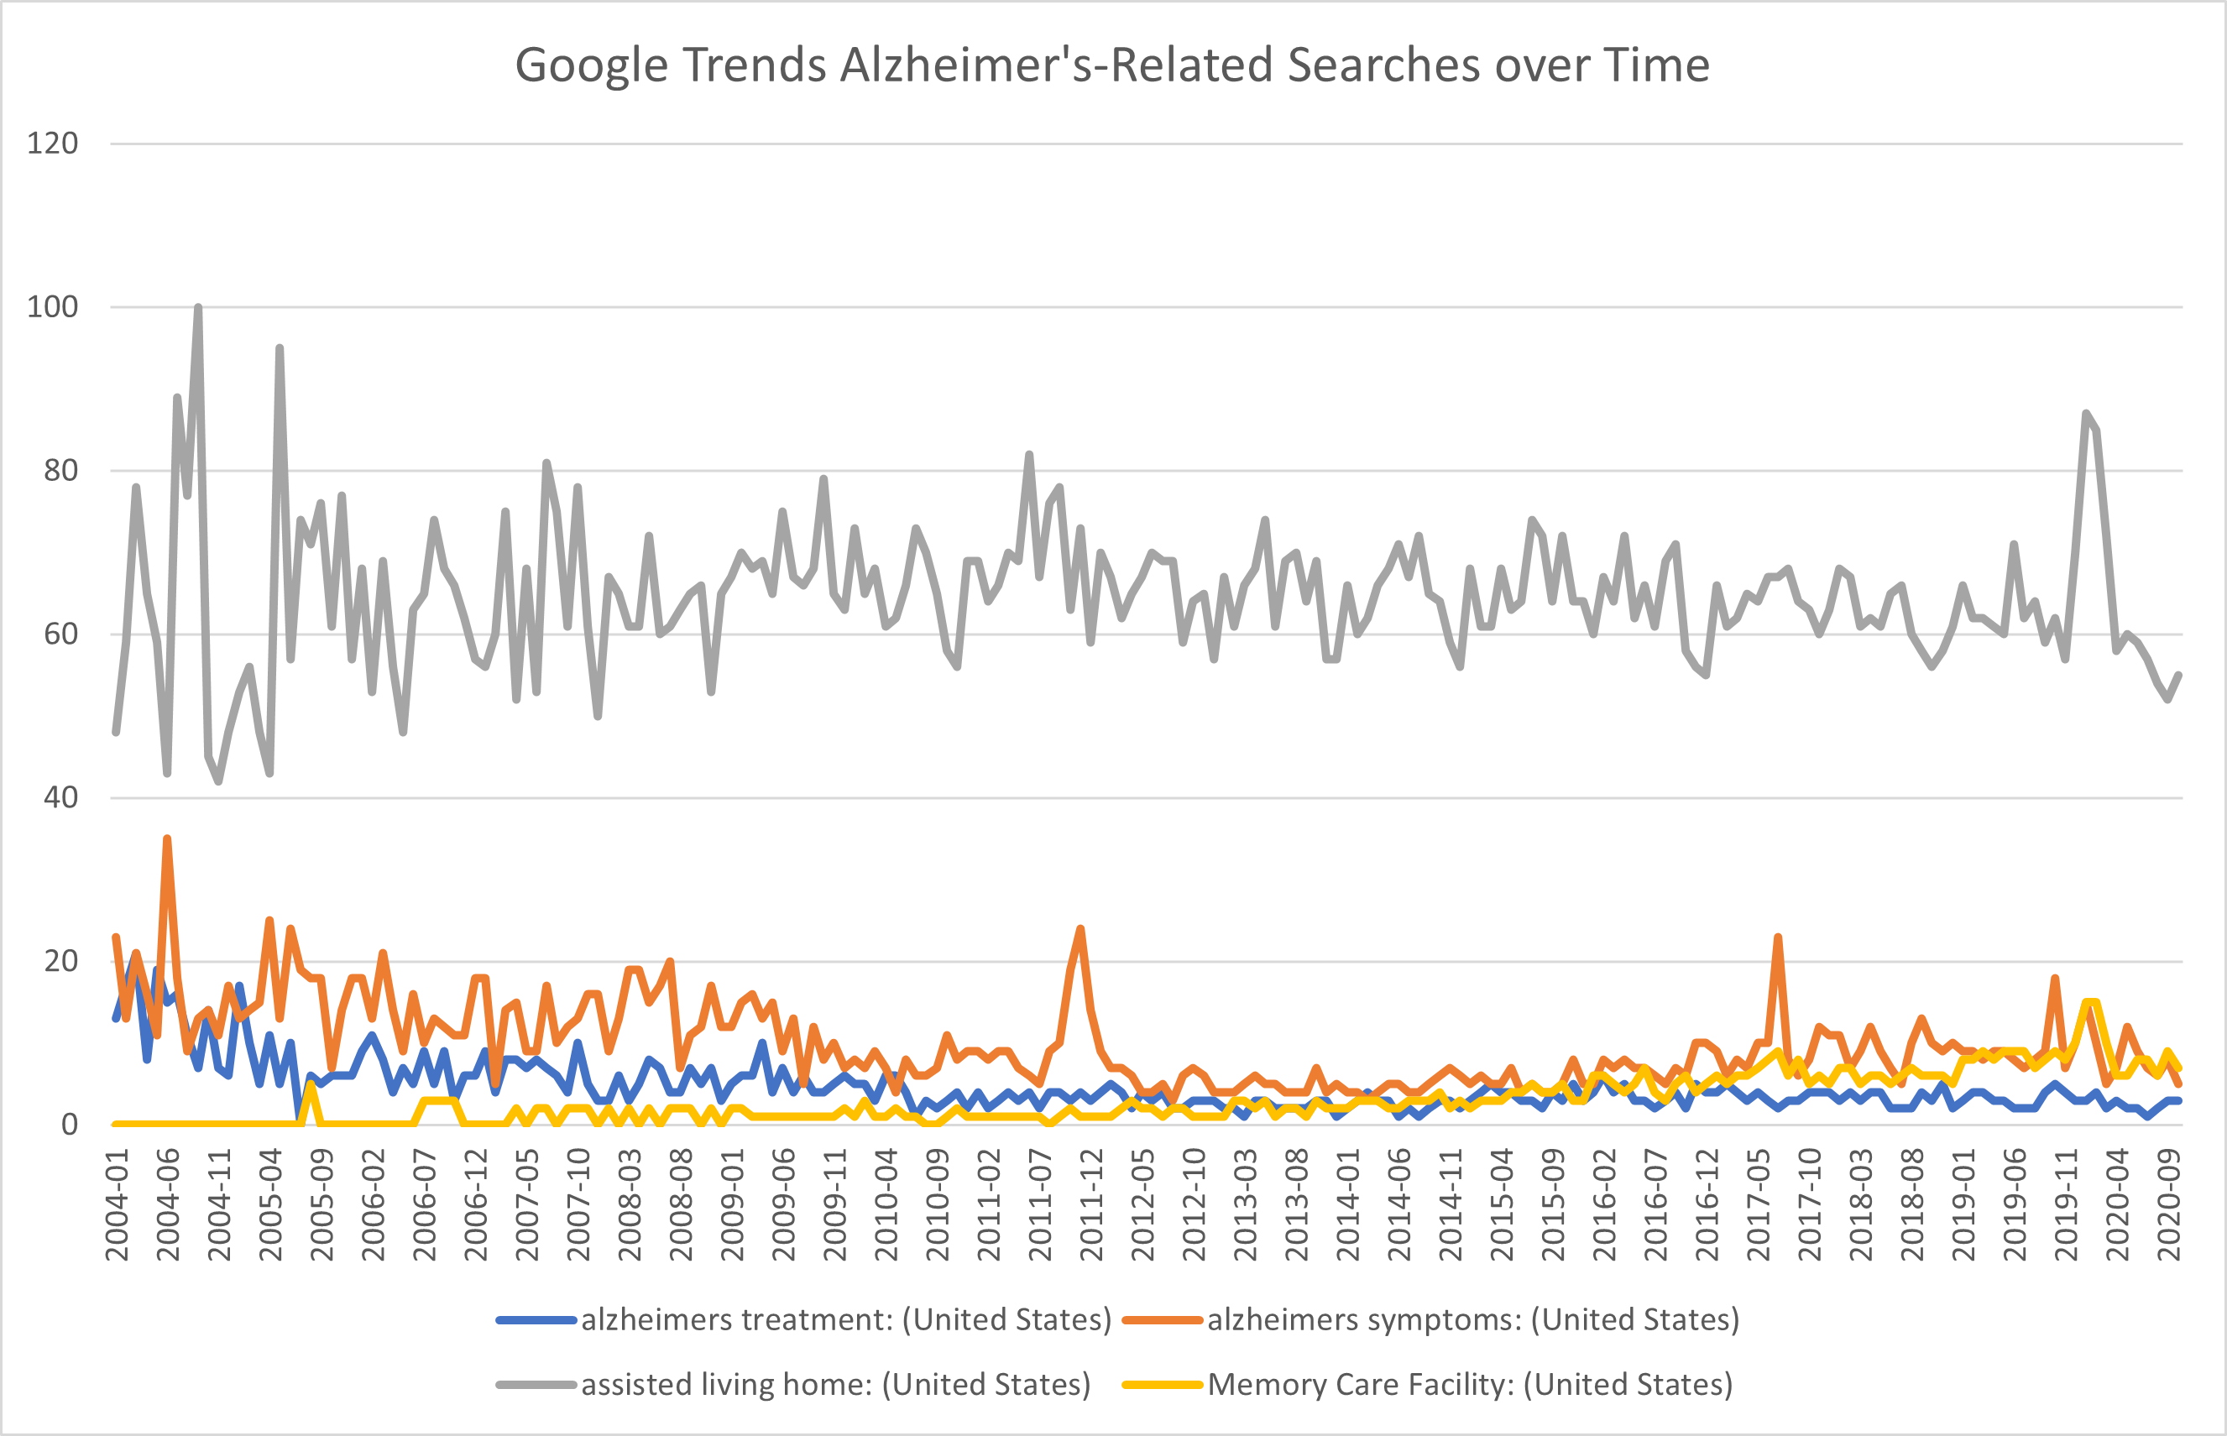
Google Trends
With Google Trends data, we can see heavy spikes in information regarding Alzheimer’s and assisted-living facilities in 2004, 2011, and smaller spikes in recent times
Early spikes may be the popularization of the term
Recent spikes may indicate a spike in prevalance

Slide 4
Google Trends
It is important to note that while the largest bar in our Google Trends graph follows the same trends as those for memory care facilities and searches for Alzheimer’s symptoms, assisted living homes are not solely defined for those affected by Alzheimer’s or dementia
As time progresses, we would expect that searches for these terms would increase going forward as well, based on data in the following slides, thus further analysis and tracking would need to be done here
Additionally, we could add more search terms, such as medications that aim to treat dementia

Slide 5
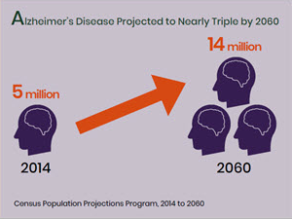
CDC Research
Based on CDC data, which is highly reputable, numbers are expected to nearly triple in next 40 years
Also reported, “Death rates for Alzheimer’s disease are increasing, unlike heart disease and cancer death rates which are on the decline” (CDC, 2020)

Slide 6
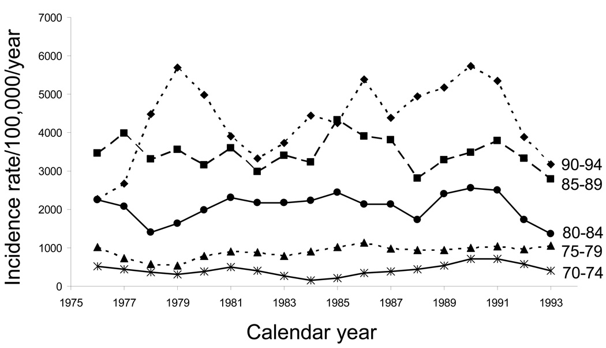
Medical Studies
Based on data shown in Alzheimer’s Dement (Rocca et al., 2011), over the time period from 1975-1993, a statistically significant (p=0.004) downward trend of Alzheimer’s Disease of about 3% a year is shown

Slide 7
Medical Studies
It is important to note that this data, while showing a downward trend and conducted in 2011, only contains data leading up to the year 1993, as that was most current data provided
Obviously, updated studies with more current data would need to be run, and if other research maintained here is correct, would likely indicate a trend in the opposite direction
Lastly, clarification in the amount of patients suffering from symptoms of dementia vs. Alzheimer’s could be important as they are closely related

Slide 8
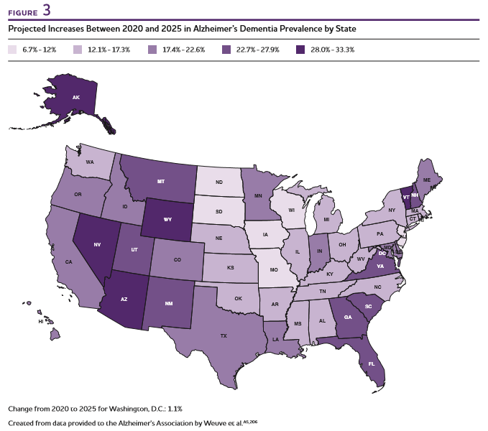
Projected Increases by State
Based on data shown by Alzheimer’s Association, within the next 5 years they are showing increase in every state in number of elderly affected by Alzheimer’s by at least 6.7-12%, with states like Nevada, Arizona, and Wyoming having increases of up to 33.3%

Slide 9
Underreported Cases
“The second study, published online on March 5, 2014, found that the number of deaths due to Alzheimer’s disease in people 75 and older could be six times higher than the official count (James et al. 2014)”
“A new study published in the medical journal of the American Academy of Neurology questions the usefulness of the death certificate method and subsequently reports that Alzheimer’s may actually be the third leading cause of death – right behind heart disease and cancer.” (Cure Alzheimer’s Fund, 2018)

Slide 10
Underreported Cases
Again, we can see through these documents that further research would need to be done to solidify the claims provided from both sources
Additionally, as mentioned in previous summary on medical studies, differentiating between symptoms linked to dementia and that of Alzheimer’s could further draw into question the number of individuals suffering from the disease (think of how hard it can be to similarly define COVID-19 from the flu)

Slide 11
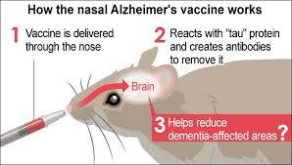
Vaccine Possibilities?
“Although this research is promising, it is too early to get excited. Any human benefit from this vaccine is many years away at best” – Dr. Alex Mroszczyk
Potential for decrease in prevalence of Alzheimer’s due to scientific intervention has found recent breakthroughs, though many are skeptic (Ries, 2019)

Slide 12
Summary
In each of these examples, save the medical study showing a slight decrease based on data ending in 1993, we have seen current data increasing nationwide
We have seen multiple organizations project increasing of prevalence of up to 3 times the current number of Americans suffering from Alzheimer’s, and shown that the current number of those suffering may be much higher than reported
On a positive note, we have also demonstrated that a current study into a vaccine at University of New Mexico has shown promise, though it may take years to find validity and clinical trials if it reaches that point
To these ends, we would hope that medical studies that include more modern data would be run to investigate current populations suffering from dementia, clarify and further identify the reporting differences between Alzheimer’s and dementia, and improve current healthcare systems to help catch those early onset Alzheimer’s cases to nail down exact numbers in current times
Finally, we’d aim to continue monitoring and tracking these numbers to ensure that the current expectations and projections are accurate

Slide 13
References:
BBC. (n.d.). Demographic transition model - Population growth and change - CCEA - GCSE Geography Revision - CCEA. BBC Bitesize. https://www.bbc.co.uk/bitesize/guides/zpgjk2p/revision/2
CDC. (2020, June 2). What is Alzheimer’s Disease? | CDC. Center for Disease Control. https://www.cdc.gov/aging/aginginfo/alzheimers.htm
CureAlz. (2018, February 26). New Study Shows Alzheimer’s Deaths are Severely Underreported. Cure Alzheimer’s Fund. https://curealz.org/news-and-events/new-study-shows-alzheimers-deaths-are-severely-underreported/
Hastings, L. (2020, June 23). Alzheimer’s Statistics: 2020 Facts and Figures. SafelyYou. https://www.safely-you.com/single-post/2020/06/23/alzheimers-statistics-facts-and-figures/
National Institute of Aging. (2014, May 22). Number of Alzheimer’s deaths found to be underreported. https://www.nia.nih.gov/news/number-alzheimers-deaths-found-be-underreported
Nonaka, R. (2020, May 10). Nasal vaccine for Alzheimer’s cuts atrophied brain matter in mice : The Asahi Shimbun. http://www.asahi.com/ajw/articles/13273986
Ries, J. (2019, June 12). An Alzheimer’s Vaccine Won’t Be Approved Anytime Soon, Here’s Why. Healthline. https://www.healthline.com/health-news/dont-bet-on-an-alzheimers-vaccine-anytime-soon#Early-stages-of-research
Rocca, W. A., Petersen, R. C., Knopman, D. S., Hebert, L. E., Evans, D. A., Hall, K. S., Gao, S., Unverzagt, F. W., Langa, K. M., Larson, E. B., & White, L. R. (2011). Trends in the incidence and prevalence of Alzheimer’s disease, dementia, and cognitive impairment in the United States. Alzheimer’s & Dementia, 7(1), 80–93. https://doi.org/10.1016/j.jalz.2010.11.002
wlo22family. (2020). Alzheimer’s Disease 2020 Facts and Statistics | AIM. Aging in Maine. https://aginginmaine.com/alzheimers-disease-2020-facts-and-statistics/

